Slide 1


Optimization and Simulation Simulation project
“Airline Yield Management”
Group 4:
Florian Aymanns
Vasiliki Bikia
Dimitrios Tsitsokas
MATH-600: Optimization and Simulation
10/04/2018
1/21

Slide 2
Yield management: a variable pricing strategy based on understanding and anticipating consumer behavior in order to maximize revenue or profits.
*Source: https://en.wikipedia.org/wiki/Yield_management
MATH-600: Optimization and Simulation
10/04/2018
2/21

Slide 3
Project Description
A single flight scheduled from Geneva to Washington, DC.
The airline company:
- offers nine fare products;
- classifies the passengers into three segments (Business, Leisure, Economy).
Each passenger segment has a different arrival rate.
Passengers from each segment have similar behavior represented by preference weights for each fare.
The plane has a capacity of 180 seats.
MATH-600: Optimization and Simulation
10/04/2018
3/21

Slide 4
Discrete event simulation
State variables:
t: Time
revenues: Revenue at time events
segments: Segment type at time events
Parameters (scenario):
.PLANNING_HORIZON: Planning horizon
.NUMBER_OF_PRODUCTS: Number of fare products
.MaxLAMBDA_BUSINESS:
.MaxLAMBDA_LEISURE: Maximum arrival rates for each passenger segment
.MaxLAMBDA_ECONOMY:
.BusinessWeights:
.LeisureWeights: Preference weights vectors for each passenger segment
.EconomyWeights:
.revenues: Revenue for each fare product
.CaseIndex: Scenario index
MATH-600: Optimization and Simulation
10/04/2018
4/21

Slide 5
Discrete event simulation
Control variables:
available_seats_for_fare: Booking limit for each fare
available_fares: Available products at time events
SELECT
YOUR FARE
MATH-600: Optimization and Simulation
10/04/2018
5/21

Slide 6
Discrete event simulation
Generating arrival rates for the three segments
Simulation starts
NewEvent.m based on time and segment type
Event List is updated
UpdatedEventList.m
Arrival rates are sorted by chronological order (negative)
First event is drawn from the list
Selection of fare product
Next event is generated and added to the list
sample_fare_product.m
based on preference weights
MATH-600: Optimization and Simulation
10/04/2018
6/21

Slide 7
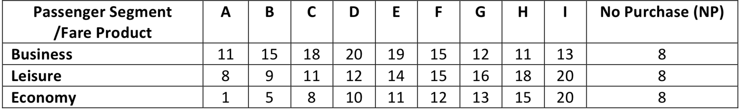
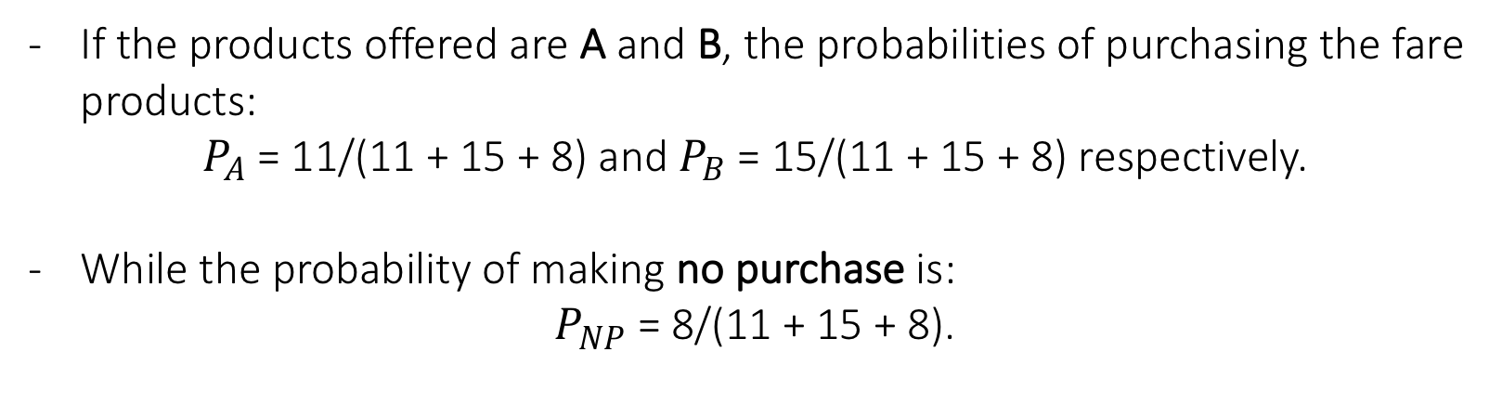
Discrete event simulation – An example
Table 1: Passenger segment/fare product preference weights
A business costumer arrives. The arrival rate is: 𝜆(𝑡) = 1.2 sin 𝑡
If the products offered are A and B, the probabilities of purchasing the fare products:
$P_{A}$= 11/(11 + 15 + 8) and $P_{B}$= 15/(11 + 15 + 8) respectively.
While the probability of making no purchase is:
$P_{NP}$ = 8/(11 + 15 + 8).
MATH-600: Optimization and Simulation
10/04/2018
7/21

Slide 8
Two scenarios to be investigated
All fares available from t = 179.
Only one product offered at a time. Starting with the most cost-effective product to the most expensive one. Continues till all fare products are sold out or plane departure.
Booking limit of 20 seats for both scenarios.
MATH-600: Optimization and Simulation
10/04/2018
8/21

Slide 9
Metrics
Number of “No purchases”
Number of passengers that couldn’t purchase (flight fully-booked)
Quality of Service
Total revenue
Company’s profit
MATH-600: Optimization and Simulation
10/04/2018
9/21

Slide 10
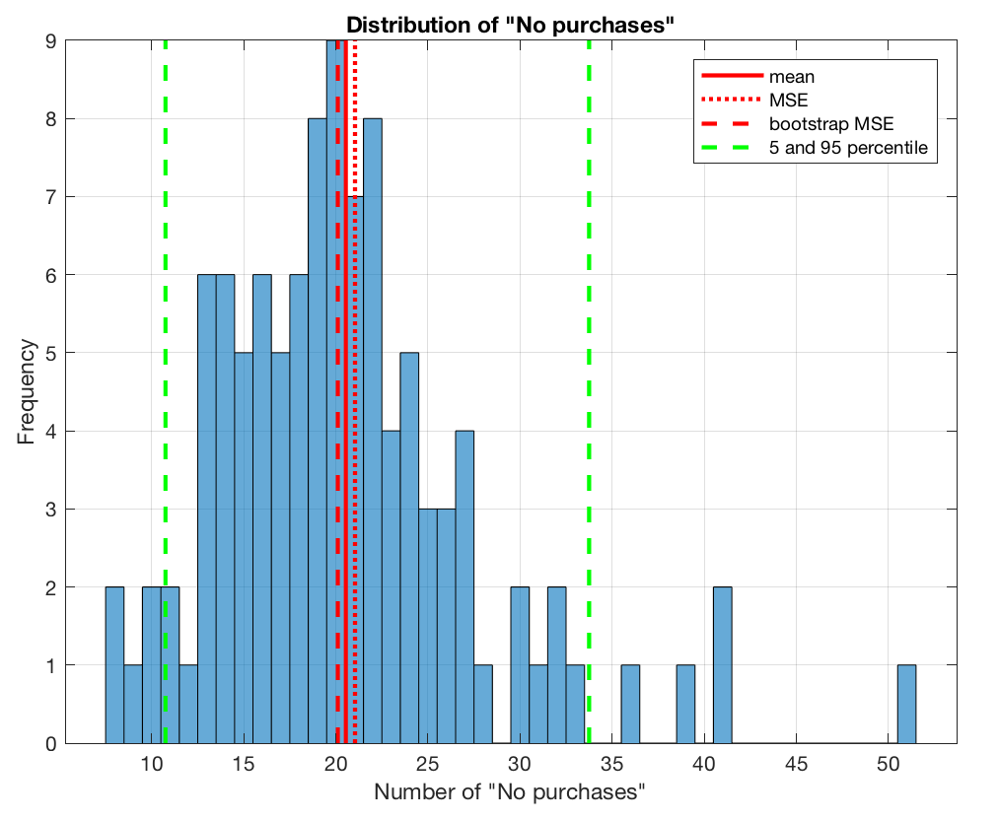
Scenario (1) - Results
Statistics of mean-of-number-of-no purchase:
Mean = 20.54 (MSE = 0.50, BootstrapMSE = 0.44)
5 percentile = 10.75
95 percentile = 33.75
Worst = 51
MATH-600: Optimization and Simulation
10/04/2018
10/21

Slide 11
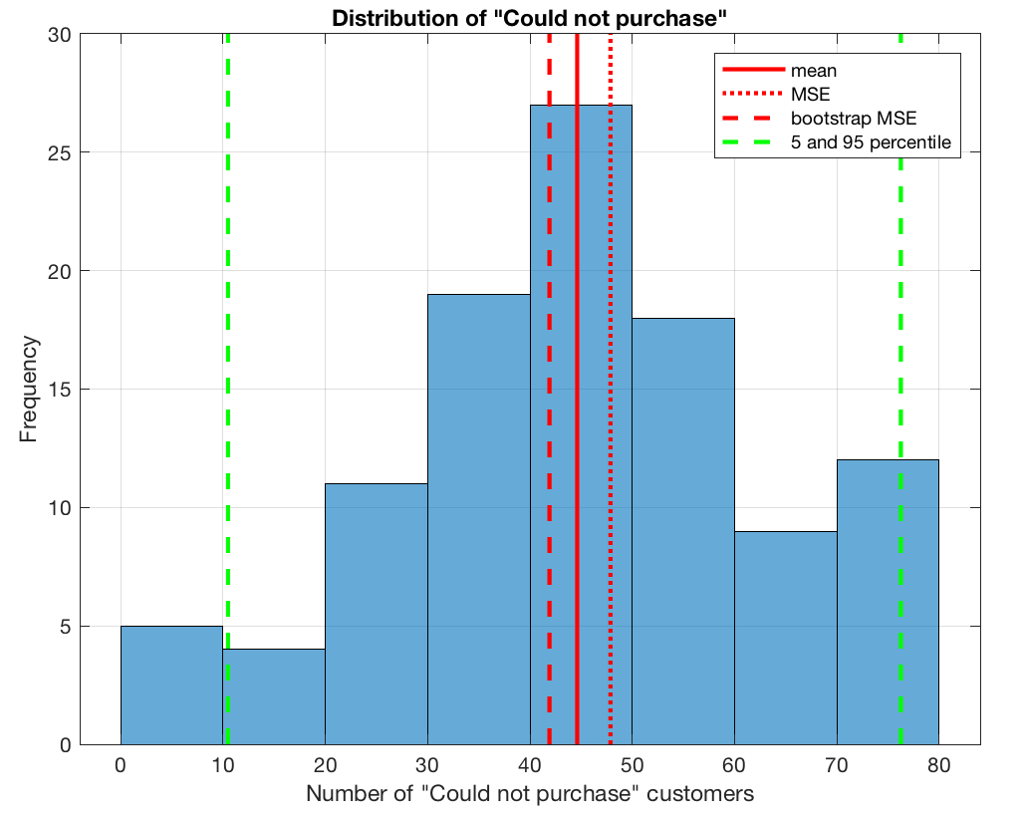
Scenario (1) - Results
Statistics of mean-of-number-of-couldn’t- purchase:
Mean = 44.62 (MSE = 3.25, BootstrapMSE = 2.71)
5 percentile = 10.5
95 percentile = 76.25
Worst = 80
MATH-600: Optimization and Simulation
10/04/2018
11/21

Slide 12
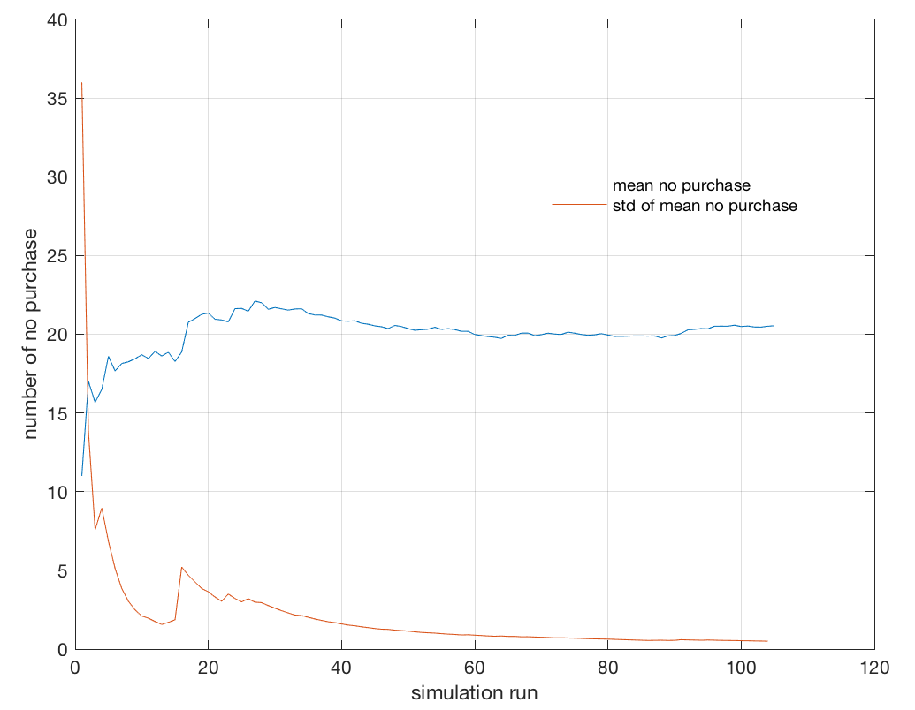
Scenario (1) - Results
MATH-600: Optimization and Simulation
10/04/2018
12/21

Slide 13
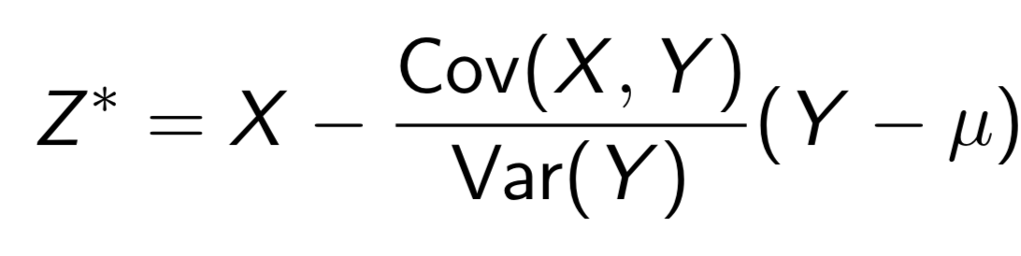
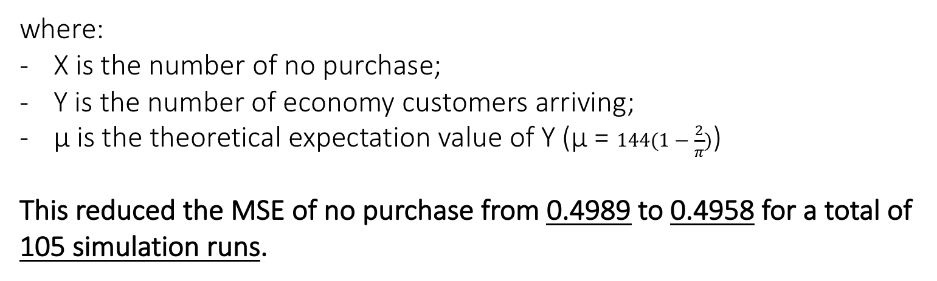
Scenario (1) - Variance Reduction | Control Variates
where:
X is the number of no purchase;
Y is the number of economy customers arriving;
μ is the theoretical expectation value of Y (μ = $144(1−\frac{2}{π})$)
This reduced the MSE of no purchase from 0.4989 to 0.4958 for a total of 105 simulation runs.
MATH-600: Optimization and Simulation
10/04/2018
13/21

Slide 14
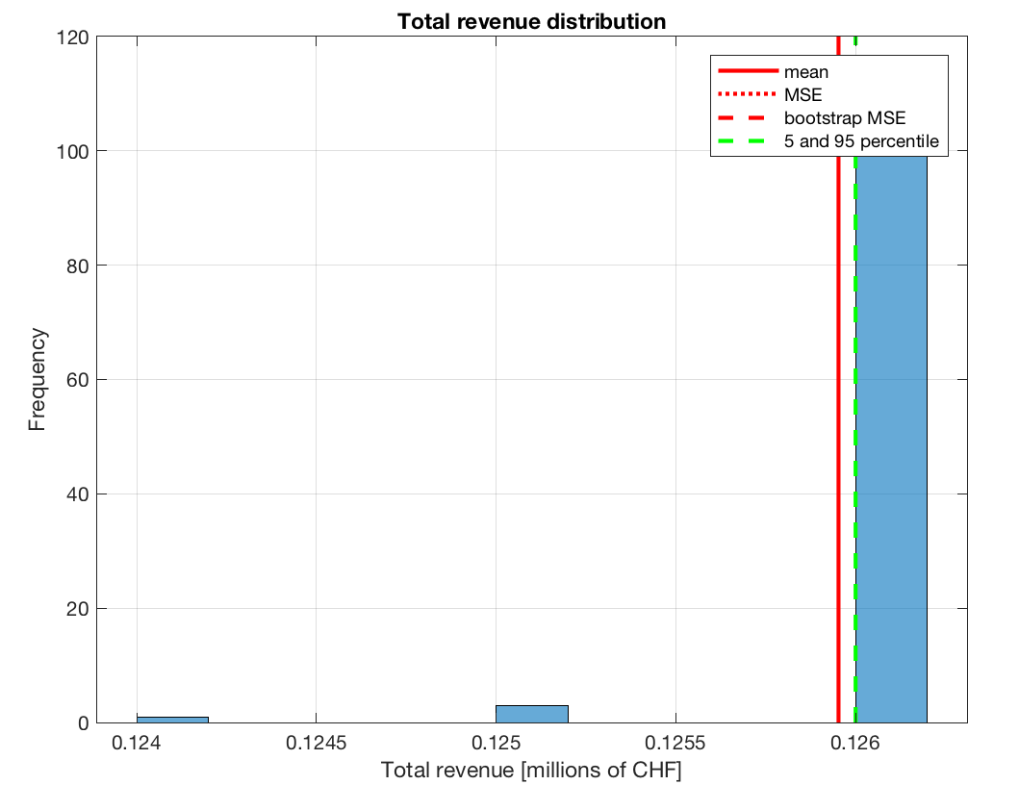
Scenario (1) - Total revenue
Statistics of mean-of-total-revenue:
Mean = 125950 (MSE = 619.22, BootstrapMSE = 571.43)
MATH-600: Optimization and Simulation
10/04/2018
14/21

Slide 15
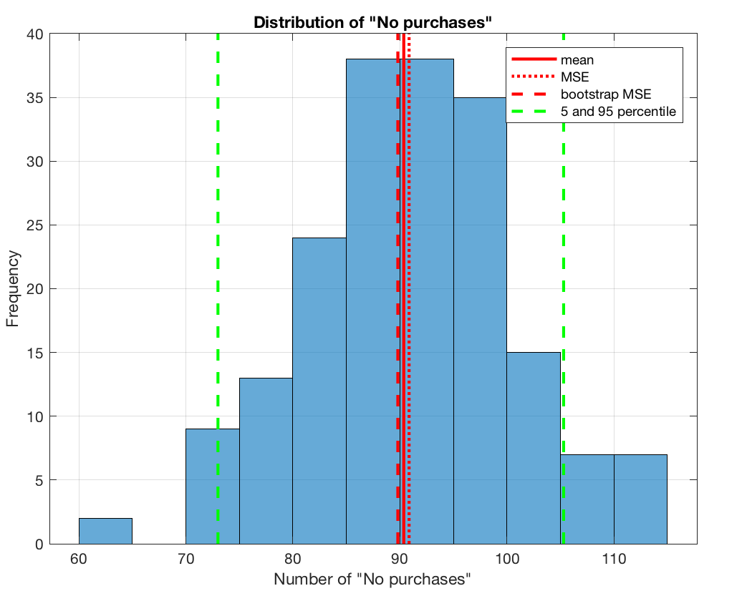
Scenario (2) - Results
Statistics of mean-of-number-of-no purchase:
Mean = 90.36 (MSE = 0.50, BootstrapMSE = 0.55)
5 percentile = 73
95 percentile = 105.3
Worst = 113
MATH-600: Optimization and Simulation
10/04/2018
15/21

Slide 16
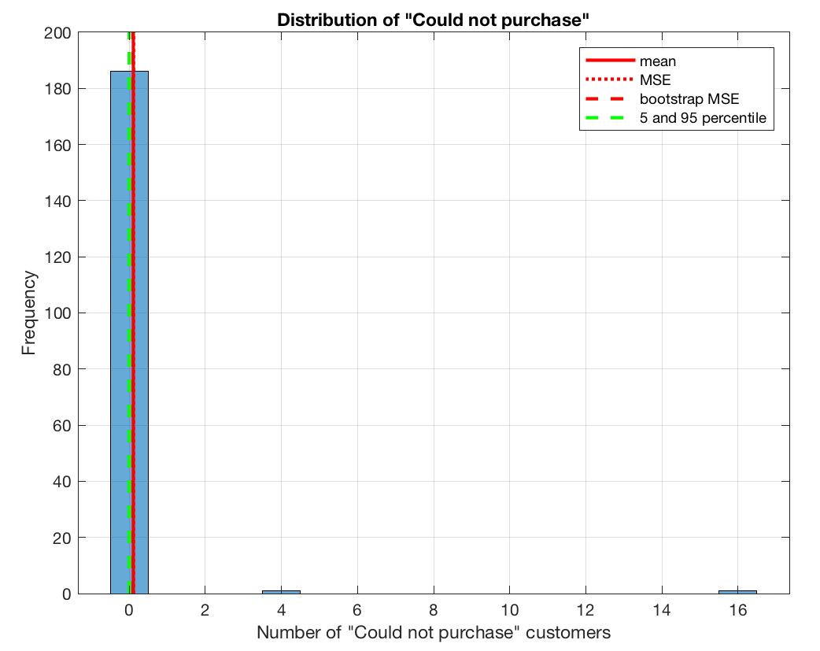
Scenario (2) - Results
Statistics of mean-of-number-of-couldn’t- purchase:
Mean = 0.11 (MSE = 0.01, BootstrapMSE = 0.01)
Worst = 16
MATH-600: Optimization and Simulation
10/04/2018
16/21

Slide 17
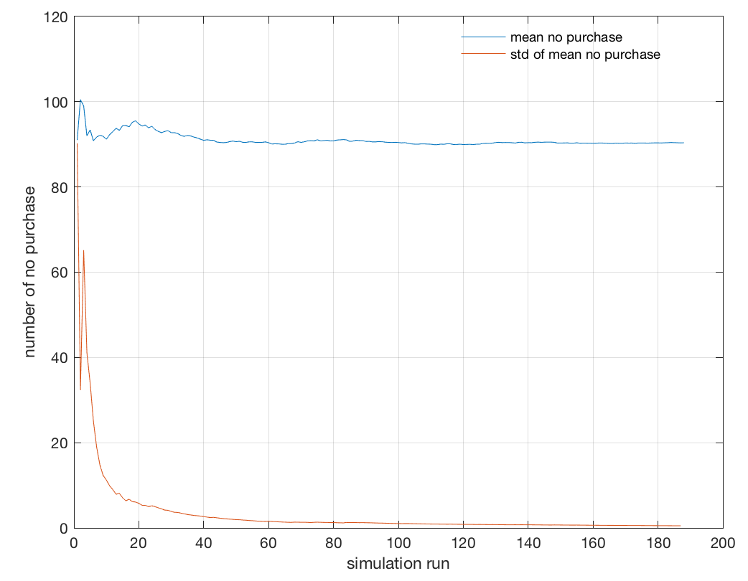
Scenario (2) - Results
MATH-600: Optimization and Simulation
10/04/2018
17/21

Slide 18
Scenario (2) - Variance Reduction | Control Variates
This reduced the MSE of no purchase from 0.4990 to 0.4200 for a total of 188 simulation runs.
MATH-600: Optimization and Simulation
10/04/2018
18/21

Slide 19
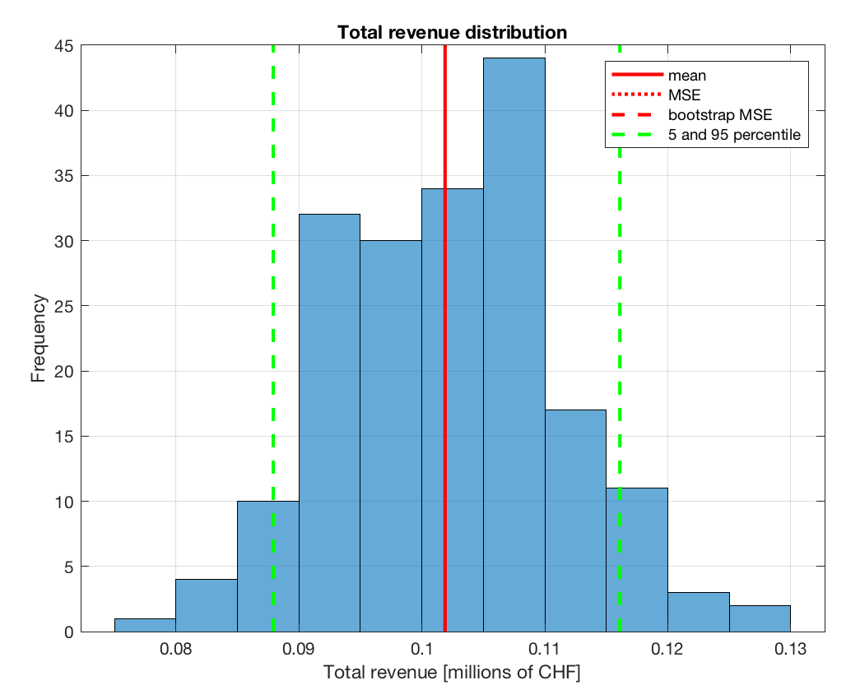
Scenario (2) - Total revenue
Statistics of mean-of-total-revenue:
Mean = 101880 (MSE = 434160, BootstrapMSE = 545010)
5 percentile = 87915
95 percentile = 116100
Worst = 79500
MATH-600: Optimization and Simulation
10/04/2018
19/21

Slide 20
Discussion
Quality of Service:
The 1st scenario results to fewer passengers deciding NOT to purchase a product comparing to 2nd scenario (avg. values ≈ 20 vs 90) First scenario offers better quality of service (less missed customers)
Flight gets sold out almost always during the 1st scenario (leaving on avg. 46 passengers unable to purchase a seat – not enough for a second flight) while in the 2nd this is a very rare case (on avg. 24 seats remain unsold).
Total revenue:
Maximum revenue for the 1st scenario in almost all cases - all fares sold out 126 k CHF - while in the 2nd scenario the average revenue is 106 k but it has a wider distribution Higher probability of lower than the average total revenue
MATH-600: Optimization and Simulation
10/04/2018
20/21

Slide 21
Thank you!
MATH-600: Optimization and Simulation
10/04/2018
21/21

